Slide 1

ISDS 556 - TEAM 2 PROJECT
PUGLIA WINERY CASE
PROF: PENG LIU
Presented by: Sairaj Jadhav
Ray Lien
Pragati Ingole
Mine Salman
Vishnu Menon

Slide 2
CONTENTS
01
02
03
Overview
Functionalities and features of the BI system
Data Models
04
05
06
07
Recommended Architecture
Summary, conclusion & recommendation for action
Data Analysis
ETL

Slide 3



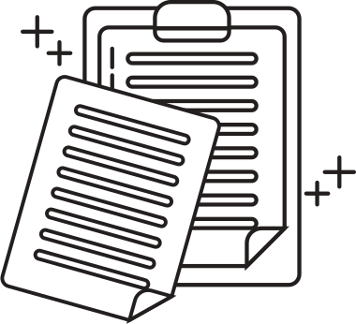

OVERVIEW
Gaps
1. The winery requires a real-time dashboard to obtain valuable insights and enhance decision-making processes to foster business growth.
2. The lack of integration between Production and Sales systems with merchants creates challenges in analyzing data for informed decision-making.
3. Conducting time-based analysis becomes complicated due to the absence of a centralized repository for storing historical data, making access difficult.
Organization readiness
1.The management is prepared and willing to make investments in implementing the solution.
2. Mr. Jack Gillespie acknowledges the need for a data warehousing solution to uphold the product's exclusivity.
3. The winery may need to recruit skilled personnel to provide support for the proposed warehouse solution

Slide 4

PRODUCT PROFITABILITY ANALYSIS:
Data Integration:
Extract product information and costs from the production system, allowing us to analyze profitability.
Market Comparison:
Users can compare sales and profitability across different markets, guiding strategic decisions.
Time Period Analysis:
Users can examine profitability over different time frames, from yearly to monthly, uncovering trends and seasonal variations.

Slide 5
KEY CUSTOMER IDENTIFICATION
Data Integration:
Relevant customer data and sales details will be extracted from the merchant sales system.
Market Comparison:
he system will calculate unit sales, dollar sales, cost, and margin for each product and wine type.
Time Period Analysis:
Users can examine profitability over different time frames, from yearly to monthly, uncovering trends and seasonal variations.

Slide 6
MARKET PROFITABILITY ASSESSMENT
Data Integration:
Sales data from various markets, including California, the rest of the US, and international markets, will be gathered.
Market Comparison:
Users can compare sales and profitability across different markets, guiding strategic decisions.
Time Period Analysis:
The system enables monitoring market performance over various time frames, allowing for trend identification.

Slide 7


ADDITIONAL FEATURES:
Data Visualization
Forecasting and Predictive Analytics
Data Drill-Down
Data Security and Access Control
Mobile Compatibility
Alerts and Notifications
Ad-hoc Querying

Slide 8





DATA MODEL
HIGH UNDERSTANDIBILITY
DATA AGGREGATION
In OLAP, focus on high understandability, flexible data analysis, and reporting efficiency.
The main concern for reporting is efficiency due to its time-saving part of aggregating data.

Slide 9

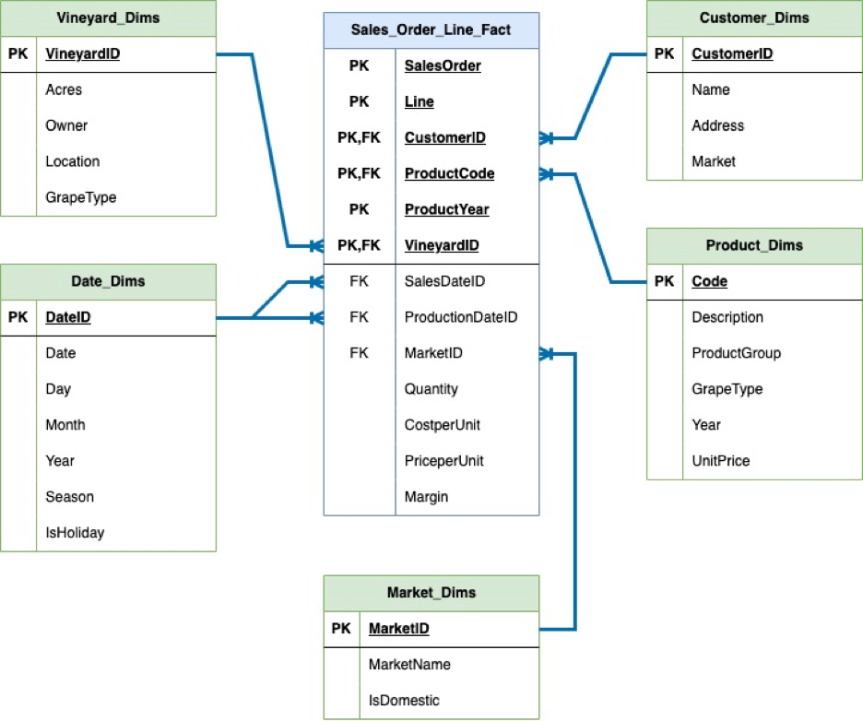
Star Schema
Fact Table (Large Volume of Sales)
Sales_Order_Line_Fact
Dimension Tables (Descriptive Information)
Customer, Product, Vineyard, Date, and Market
No snow-flaking needed
No hierarchical relationships in dimension tables
Degenerate Dimensions
Slowly Changing Dimensions (SCD)
Fast-Changing Dimensions

Slide 10


DATA ANALYSIS
Our goal with data analysis was to unlock valuable insights from the available data to address the winery's key business challenges. For this, we had access to a rich dataset comprising product information, customer details, sales transactions, production data, and market information

Slide 11
LET'S LEARN MORE ABOUT OUR DATA
Primary and Secondary Data Sources
To ensure the validity of our analysis, we identified two types of data sources - primary and secondary.
Measures of Interest and Data Source Mapping
To align the data sources with the measures of interest, we created a mapping matrix

Slide 12

LET'S CLEAN AND ANALYZE THE DATA
Prior to analysis, data cleansing was diligently performed to ensure reliable results by encompassing tasks like handling missing values, detecting outliers, and eliminating duplicates.
Data Cleansing
This is integrated production data for sales, costs, and margins by product and wine type over different time periods
Product Profitability Analysis
We extracted details from the sales system, and segmented customers into high-value, repeat, and new categories to better understand preferences and enhance tailored service.
Key Customer Identification
It utilized market-specific sales data to evaluate sales effectiveness and profitability, presenting insights through comparative dashboards to identify lucrative growth opportunities.
Market Profitability Assessment
Data Visualization and Reporting
We used Tableau/Power BI to create interactive dashboards for data-driven insights.

Slide 13




EXTRACTION, TRANSFORMATION, AND LOADING
The process involves making the data from two distinct data sources uniform and consistent. Once these information systems are aligned in terms of structure and format, the data is integrated into a unified database system using platforms like Snowflake or Microsoft SQL Server. This integration offers improved scalability and flexibility.
Real-Time or Near Real-Time Loading
Transformation
Scheduling issues
As a result, the granularity will be relatively high, and the data will be presented in more aggregated and summarized forms. This approach facilitates streamlined use, ease of implementation, and faster execution of queries, reports, and ad hoc analyses.
This approach allows for more manageable and cost-effective operations and is suitable for smaller data warehouses like the one we are designing for Puglia Winery. However, it's crucial to carefully manage each load transfer to ensure proper alignment and joining of all dimensions and fact tables.
For our situation, a near real-time loading approach would be most suitable. It is not necessary to achieve up-to-the-minute or second-by-second loading since our extraction and incremental loading processes will occur daily, specifically at the end of each day. The frequency of incremental loads will be at least once a day or every 12-24 hours, depending on the specific requirements.

Slide 14


Recommended Architecture
Backend (Backroom) Technology:
Data Integration & ETL Tools: Apache Spark or MS SQL Server Integration Services (SSIS)
Data Warehouse: Scalable platform (e.g., Amazon Redshift, MS Azure SQL DW) with star/snowflake schema
Metadata Repository: Documentation of data sources, transformations, and mappings.
Frontend (Front-room) Technologies:
Data Visualization & Reporting: Tableau, Power BI, QlikSense for interactive dashboards and reports.
Query & Analysis: OLAP and SQL-based tools for multidimensional analyses.
User Access & Security: Role-based access control for data protection.

Slide 15
Recommendation for Action:
Actions to Take:
Assess & Select BI Technologies: Choose suitable tools like Tableau, Power BI, or QlikSense.
Create Data Models: Design and build data models for efficient integration and analysis.
Establish ETL Process: Implement data extraction, transformation, and loading with Spark or SSIS.
Deploy Data Warehouse: Choose a scalable platform (e.g., AWS or Azure) for hosting the data.
Create Interactive Dashboards & Reports: Utilize visualization tools for data insights.
User Training & Security: Educate and control access through role-based restrictions.
Monitor & Improve: Continuously assess and enhance the BI system for optimal performance.

Slide 16
Summary
Puglia Winery's recommended data warehousing architecture includes backend and frontend technologies.
Robust ETL tools ensure data integration, transformation, and loading into the data warehouse.
A scalable data warehouse with star/snowflake schema optimizes query performance.
A metadata repository provides context for understanding the data.
Conclusion
The architecture empowers data-driven decision-making, overcoming challenges, and seizing opportunities.
Front-room tools offer interactive visualizations, reports, and ad hoc analyses.
Role-based access control ensures data security and privacy.

Slide 17
Thank's For Watching

